Slide 1



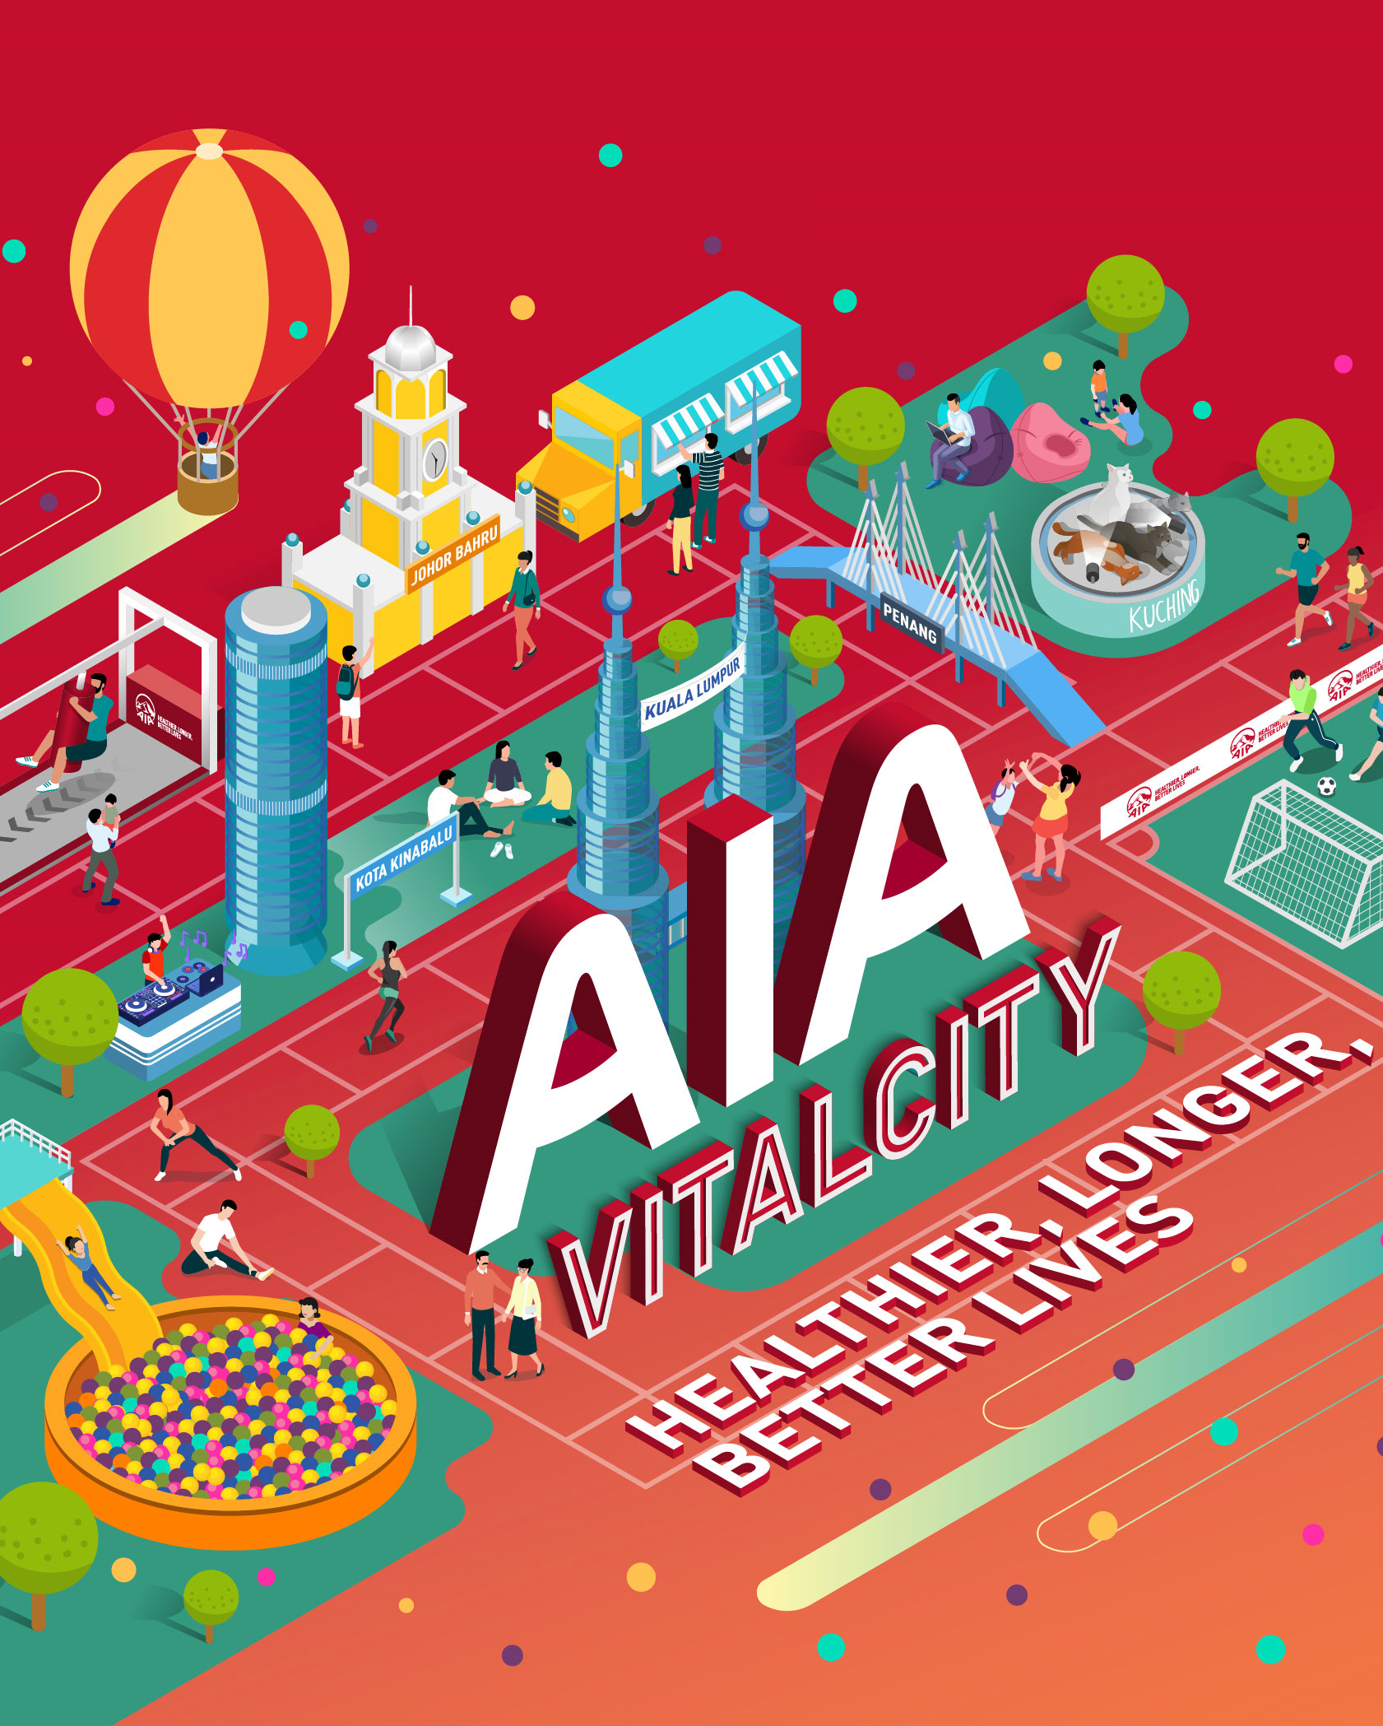





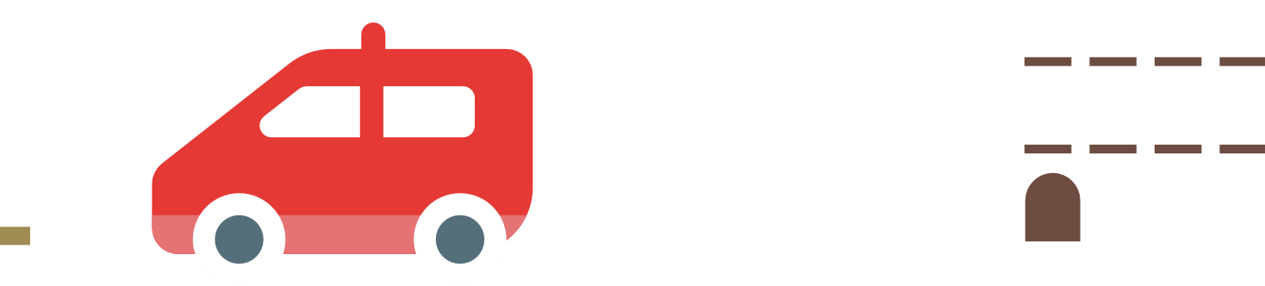
VITALCITY
- Start Living -

Slide 2



AIALife
Problem
Gamification provides an easy entry into financial literacy while encouraging consumers to be active
Consumers are not able to see the importance of financial planning and being healthy

Slide 3
AIALife
Solution
Gamification provides an easy entry into financial literacy while encouraging consumers to be active
Consumers are not able to see the importance of financial planning and being healthy
Minimize acquisition cost
Maximize lifetime value

Slide 4
AIALife
Minimize
acquisition cost
Maximize
lifetime value

Slide 5
AIALife
DEMO

